Slide 1
Neural Network Programming
Mrinal Wahal
Research Park, IIT Madras

Slide 2
First Get
The Philosphy Right
No, I won’t waste your time.

Slide 3
AI will take jobs
But not yours
But don’t hold me against it if it does.

Slide 4
The Peculiar Case Against Mathematics

Slide 5
Artificial Intelligence
A (Narrow) I
A (General) I

Slide 6
Machine Learning
Versus
Data Science

Slide 7
What Machine Learning
Can and Cannot Do
(Wrong Parcel Delivery & Self Driving Cars Example)

Slide 8
Introduction to
Machine Learning
Or so they say.

Slide 9
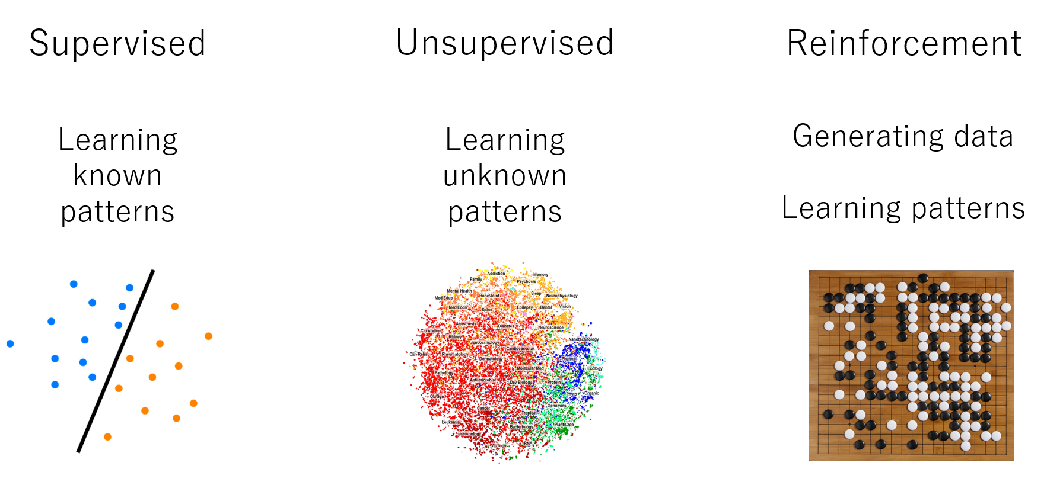

Slide 10
Collect,
Train
& Deploy
Along with a lot of head-scratching in between.

Slide 11
Explaining Neural Network programs to a 5 year old.
Okay, maybe a little older than that.

Slide 12
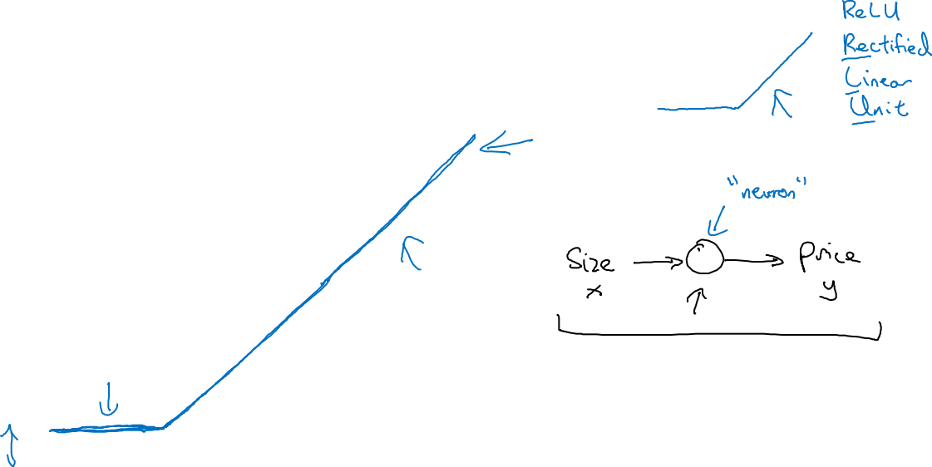
Housing Price Prediction
price
size of house

Slide 13
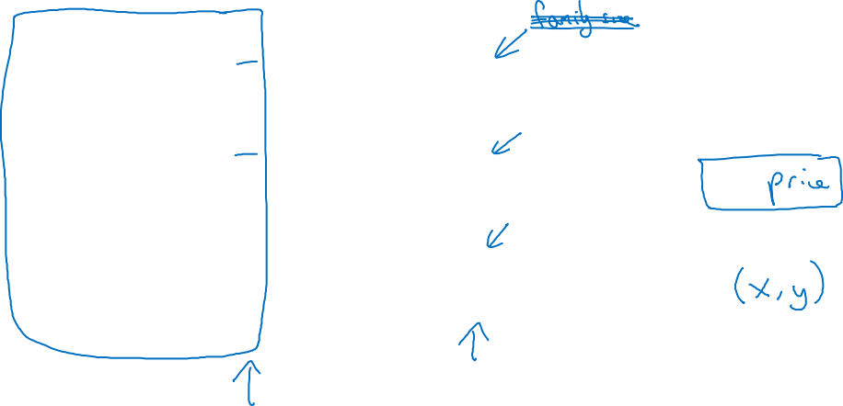
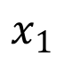
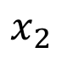
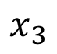
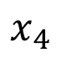
Housing Price Prediction
size
$x_{1}$
#bedrooms
$x_{2}$
y
zip code
$x_{3}$
wealth
$x_{4}$

Slide 14
XOR Function
In a Practical Simulation

Slide 15
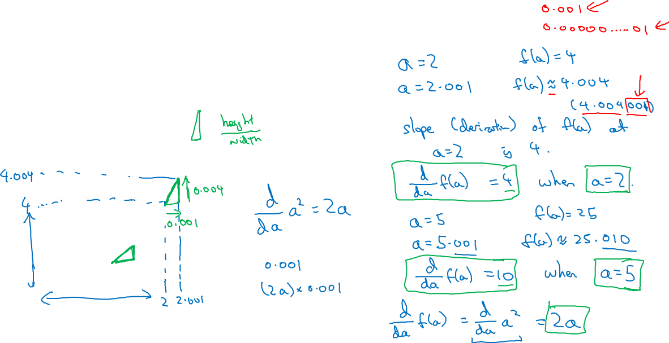
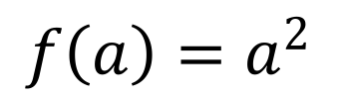
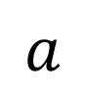
Intuition about derivatives
$f\left(a\right)=a^{2}$
$a$

Slide 16
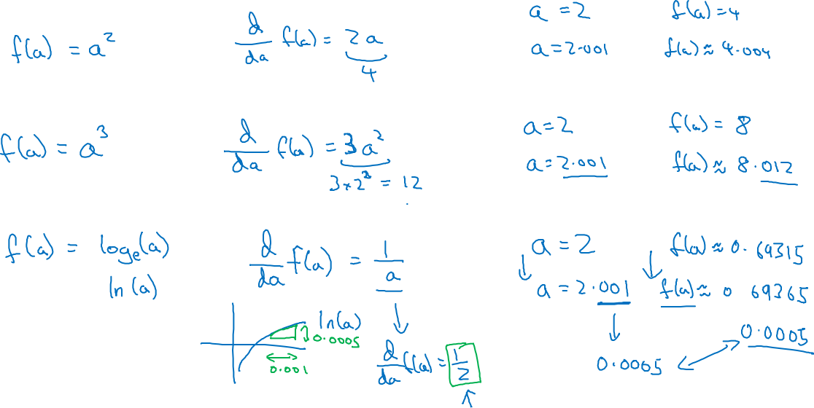

Slide 17
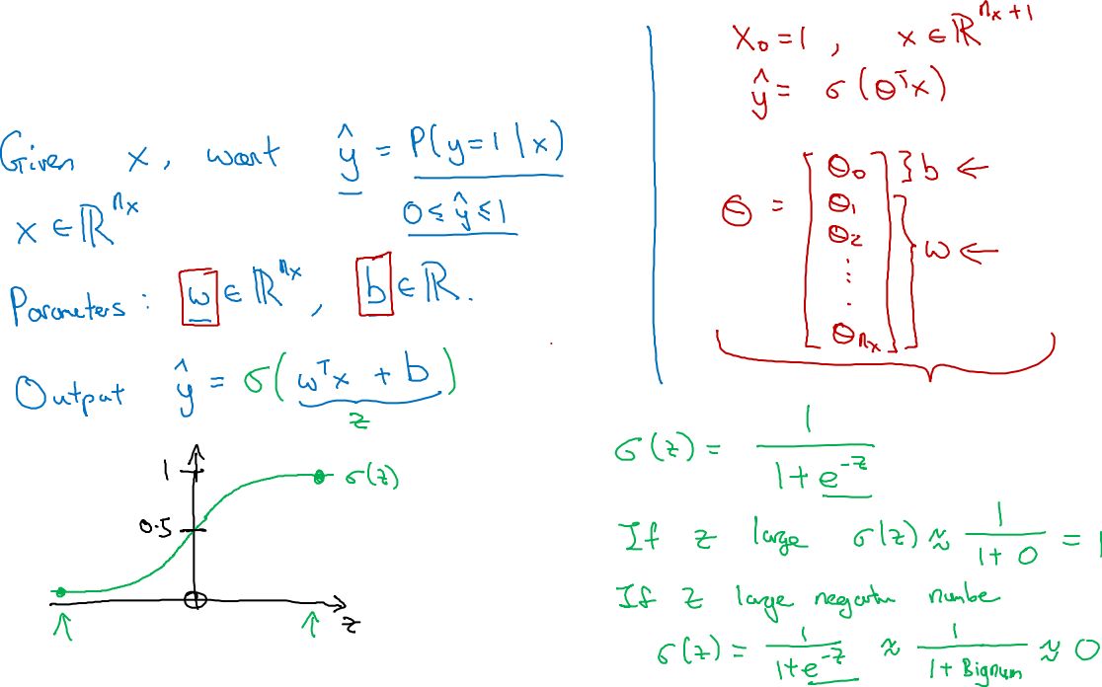
Logistic Regression

Slide 18
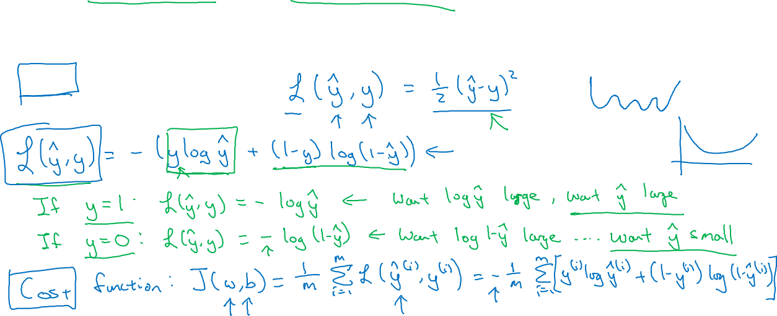
Logistic Regression cost function
, where
Given want .
Loss (error) function:

Slide 19


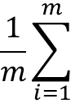
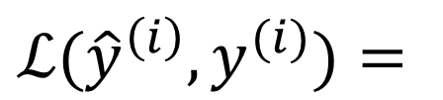
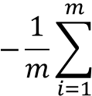
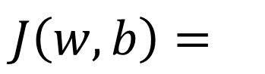
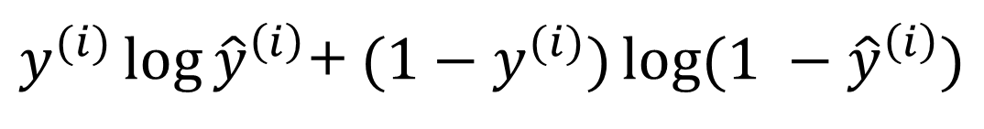

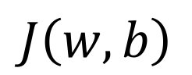
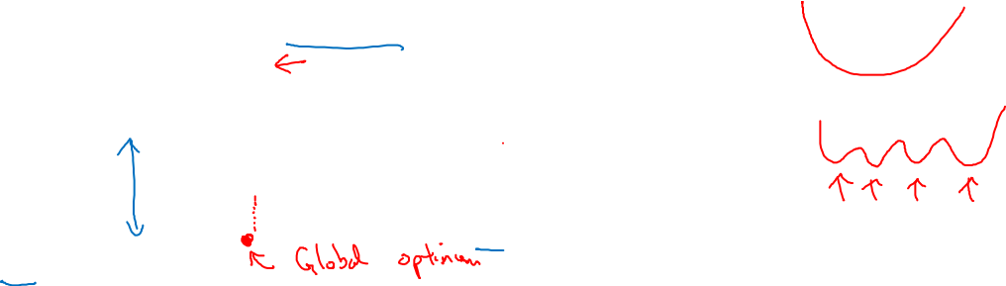
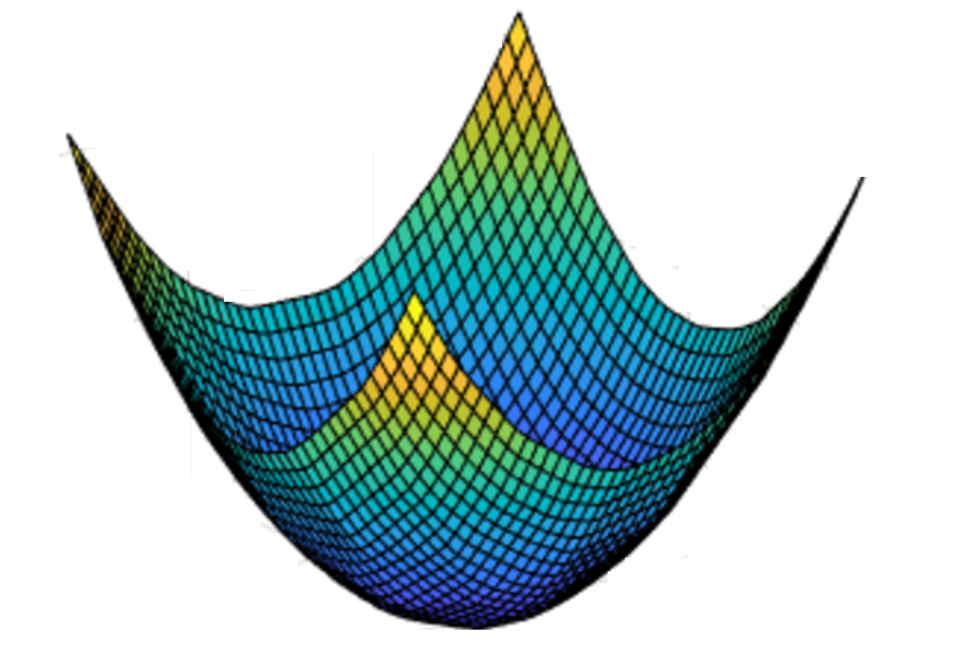
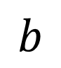

Gradient Descent
Recap: ,
$\frac{1}{m}\sum_{i=1}^{m}{}$
$−\frac{1}{m}\sum_{i=1}^{m}{}$
$J\left(w,b\right)=$
+
Want to find that minimize
$J\left(w,b\right)$
$b$
$w$

Slide 20
Wait Dude. Go slow.
Back up... Do that Again !!!
Neural Network
Representation

Slide 21
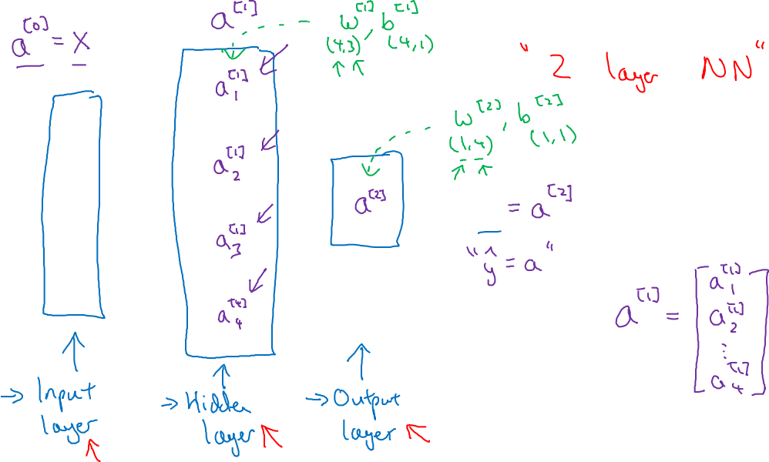
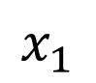
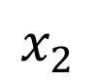
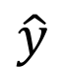
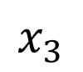
Neural Network Representation
$x_{1}$
$x_{2}$
$\hat{y}$
$x_{3}$

Slide 22
Let's Get this thing to work man !
Computing a
Neural Network’s
Output

Slide 23
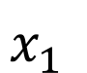
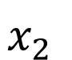
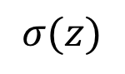
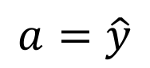

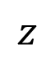
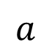
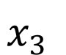

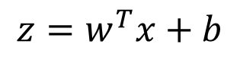
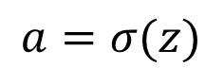
Neural Network Representation
$x_{1}$
$x_{1}$
$x_{2}$
$σ\left(z\right)$
$a=\hat{y}$
$x_{2}$
$\hat{y}$
$w^{T}x+b$
$z$
$a$
$x_{3}$
$x_{3}$
$z=w^{T}x+b$
$a=σ\left(z\right)$

Slide 24
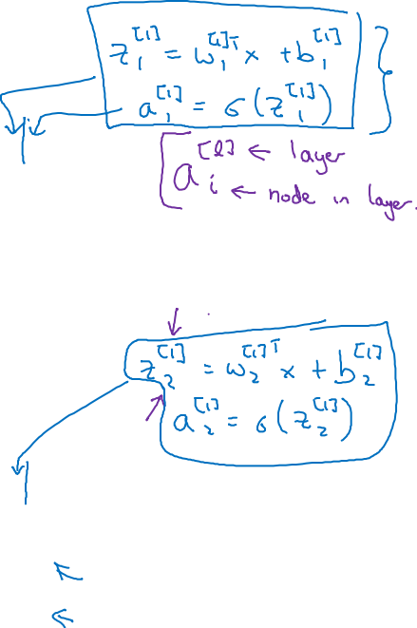

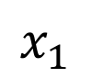
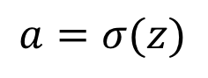
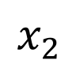

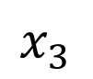
Neural Network Representation
$x_{1}$
$x_{1}$
$x_{2}$
$σ\left(z\right)$
$a=\hat{y}$
$x_{2}$
$\hat{y}$
$w^{T}x+b$
$z$
$a$
$x_{3}$
$x_{3}$
$z=w^{T}x+b$
$x_{1}$
$a=σ\left(z\right)$
$x_{2}$
$\hat{y}$
$x_{3}$

Slide 25
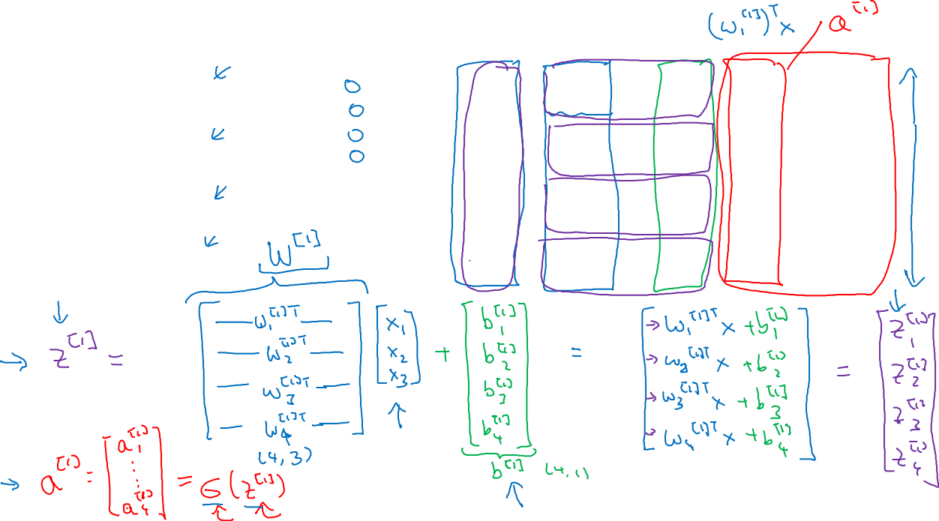
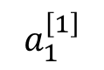
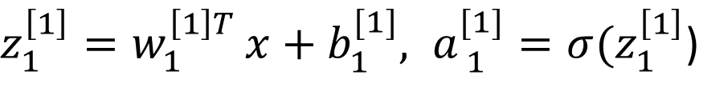
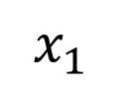
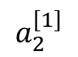
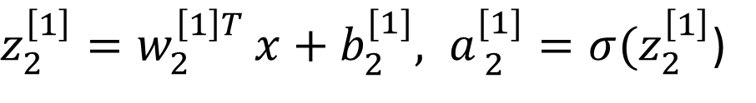
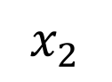
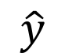
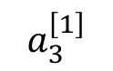




Neural Network Representation
$a_{1}^{\left[1\right]}$
)
$x_{1}$
$a_{2}^{\left[1\right]}$
)
$x_{2}$
$\hat{y}$
$a_{3}^{\left[1\right]}$
)
$x_{3}$
$a_{4}^{\left[1\right]}$
)

Slide 26





Neural Network Representation learning
$a_{1}^{\left[1\right]}$
Given input x:
$x_{1}$
$a_{2}^{\left[1\right]}$
$z^{\left[1\right]}=W^{\left[1\right]}x+b^{\left[1\right]}$
$x_{2}$
$\hat{y}$
$a_{3}^{\left[1\right]}$
$x_{3}$
$a^{\left[1\right]}=σ\left(z^{\left[1\right]}\right)$
$a_{4}^{\left[1\right]}$
$z^{\left[2\right]}=W^{\left[2\right]}a^{\left[1\right]}+b^{\left[2\right]}$
$a^{\left[2\right]}=σ\left(z^{\left[2\right]}\right)$

Slide 27
Forward Propagation Implementation in Python
[ Once Again ]

Slide 28



Logistic regression recap
$z=w^{T}x+b$
$\hat{y}=a=σ\left(z\right)$
$ℒ\left(a,y\right)=−$

Slide 29








Logistic regression derivatives
$x_{1}$
$w_{1}$
$x_{2}$
$w_{2}$
b

Slide 30

Logistic regression on m examples

Slide 31
What the Fuss of
Activation functions ?

Slide 32



Pros and cons of activation functions
a
x
z
$a=\frac{1}{1+e^{−z}}$
sigmoid:
a
a
z
z

Slide 33
Little More Maths
Derivatives of
activation functions

Slide 34


Sigmoid activation function
a
$g\left(z\right)=\frac{1}{1+e^{−z}}$
z

Slide 35


Tanh activation function
a
$g\left(z\right)=tanh\left(z\right)$
z

Slide 36

ReLU and Leaky ReLU
a
a
z
z
ReLU
Leaky ReLU

Slide 37
Deep Neural Networks
Why deep
representations?
[ Finally Something Deep ]

Slide 38





Intuition about deep representation
$\hat{y}$

Slide 39
Back to Basics of Neural Network Programming
Vectorization

Slide 40


What is vectorization?

Slide 41

Neural network programming guideline
Whenever possible, avoid explicit for-loops.

Slide 42


Vectors and matrix valued functions
Say you need to apply the exponential operation on every element of a matrix/vector.
$v=\left[\begin{matrix}v_{1} \\ ⋮ \\ v_{n}\end{matrix}\right]$
u = np.zeros((n,1))
for i in range(n):
u[i]=math.exp(v[i])

Slide 43







What happens if you initialize weights to zero?
$x_{1}$
$a_{1}^{\left[1\right]}$
$a_{1}^{\left[2\right]}$
$\hat{y}$
$x_{2}$
$a_{2}^{\left[1\right]}$

Slide 44
One hidden layer
Neural Network
Random Initialization

Slide 45

Random initialization
$x_{1}$
$a_{1}^{\left[1\right]}$
$a_{1}^{\left[2\right]}$
$\hat{y}$
$x_{2}$
$a_{2}^{\left[1\right]}$

Slide 46
Answering the First Big Question.
How do I get my matrix
dimensions right ?

Slide 47





Parameters and
$x_{1}$
$\hat{y}$
$x_{2}$

Slide 48


Vectorized implementation
$x_{1}$
$\hat{y}$
$x_{2}$

Slide 49
[ Let's Add Some Typical Boring Lecture Advice ]

Slide 50
But But... what just happened ???... wait man !!! Hey... DUDE ?!
What does this
have to do with
the brain?

Slide 51













Forward and backward propagation
$Z^{\left[1\right]}=W^{\left[1\right]}X+b^{\left[1\right]}$
${dZ}^{\left[L\right]}=A^{\left[L\right]}−Y$
$A^{\left[1\right]}=g^{\left[1\right]}\left(Z^{\left[1\right]}\right)$
$dW^{\left[L\right]}=\frac{1}{m}dZ^{\left[L\right]}A^{{\left[L\right]}^{T}}$
$Z^{\left[2\right]}=W^{\left[2\right]}A^{\left[1\right]}+b^{\left[2\right]}$
$db^{\left[L\right]}=\frac{1}{m}np.\sum{\left(dZ^{\left[L\right]},axis=1,keepdims=True\right)}$
$A^{\left[2\right]}=g^{\left[2\right]}\left(Z^{\left[2\right]}\right)$
…
${dZ}^{\left[L−1\right]}=dW^{{\left[L\right]}^{T}}dZ^{\left[L\right]}{g^{′}}^{\left[L\right]}\left(Z^{\left[L−1\right]}\right)$
$A^{\left[L\right]}=g^{\left[L\right]}\left(Z^{\left[L\right]}\right)=\hat{Y}$
…
${dZ}^{\left[1\right]}=dW^{{\left[L\right]}^{T}}dZ^{\left[2\right]}{g^{′}}^{\left[1\right]}\left(Z^{\left[1\right]}\right)$
$dW^{\left[1\right]}=\frac{1}{m}dZ^{\left[1\right]}A^{{\left[1\right]}^{T}}$
$db^{\left[1\right]}=\frac{1}{m}np.\sum{\left(dZ^{\left[1\right]},axis=1,keepdims=True\right)}$

Slide 52

Binary Classification
1 (cat) vs 0 (non cat)
Blue
Green
Red

Slide 53
Nerd Stuff Alert !
Parameters vs
Hyperparameters

Slide 54

What are hyperparameters?
Parameters:

Slide 55


Applied deep learning is a very empirical process
Idea
cost
Experiment
Code
# of iterations

Slide 56
" Show me real life applications of this stuff."
Heavy Applications of Deep Learning

Slide 57
" If it's already advanced how we will progress with this futher ? "
Next-Gen Research Scopes
Artificial Intuition
Artificial Immune Systems
Quantum Machine Learning
Federated Learning
Advanced Self-Driving Cars (Computer Vision)
Imaging Human Thoughts

Slide 58
What is Oversight ?
Oversight.in
Research Funding & Collaboration
(+ the fun of open-source)

Slide 59
Resources
Gitlab.com/Wahal
Mrinal.Oversight@gmail.com
MrinalWahal.com
LinkedIn/Wahal
PDFs
Keras
Python/R/Matlab
Pre-Written Codes

